Slide 1
Real-Time Audio Classification for Arduino Car Control
Recognising Keywords and Using them to control an Arduino Car

Slide 2
Project by:
K. Aditya -24011101045
Dheeran -24011101027
Joshua -24011101044
Johan -24011101043

Slide 3
Project Overview-
This project explores the integration of audio classification to control an Arduino car using voice commands. The primary goal is to create a user-friendly interface that enables hands-free operation of the vehicle.
Key Features
Voice Input: Commands will be captured using a microphone. The audio input will be processed and recognized before being transmitted to the car for execution.
Command Set: Users can issue commands such as “up“, "left“, "right“, “down“, etc to control the car's movement and direction.
Practical Application
This project demonstrates the practical applications of audio processing and classification, showcasing how voice commands can enhance user interaction with robotic systems.

Slide 4
Main Objectives-
Real-Time Audio Processing: Convert audio data into spectrograms using Short-Time Fourier Transforms (STFT), which retain time information in the transformation from time-domain signals.
Spectrogram Classification: Use a Convolutional Neural Network (CNN) to classify the spectrogram images, trained on audio samples of people speaking commands.
Practical Application Demonstration: Showcase how audio processing and classification can be applied in robotics to enhance user interaction.

Slide 5
Arduino Car Overview-
Components Used-
Arduino Uno
L298N Motor Driver
4 BO motors and wheels
2 18650 Batteries and 9V battery
Chassi
Bluetooth Module-HC05
Jumper Wires
Software Used
Arduino IDE
Tensorflow module (python)
PyAudio module (python)

Slide 6
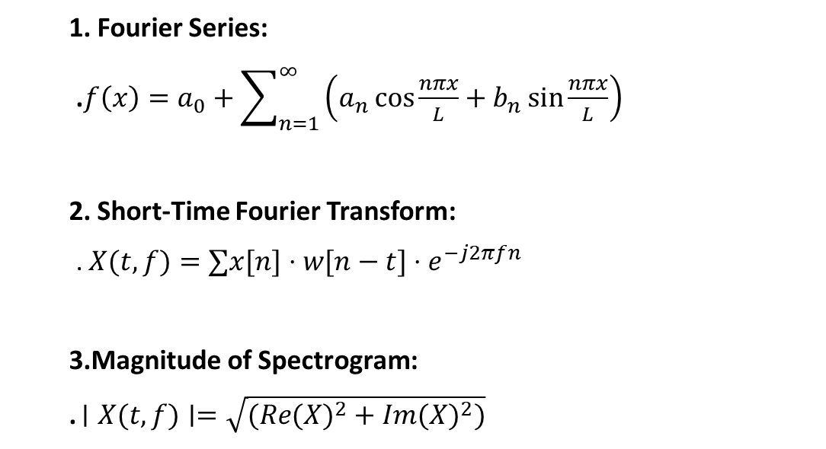
Formulas Used
1. Fourier Series:
.$f\left(x\right)=a_{0}+\sum_{n=1}^{∞}{\left(a_{n}\cos{\frac{nπx}{L}}+b_{n}\sin{\frac{nπx}{L}}\right)}$
2. Short-Time Fourier Transform:
. $X(t,f)=∑x[n]⋅w[n−t]⋅e^{−j2πfn}$
3.Magnitude of Spectrogram:
. $∣X(t,f)∣=\sqrt{(Re(X)^{2}+Im(X)^{2})}$

Slide 7
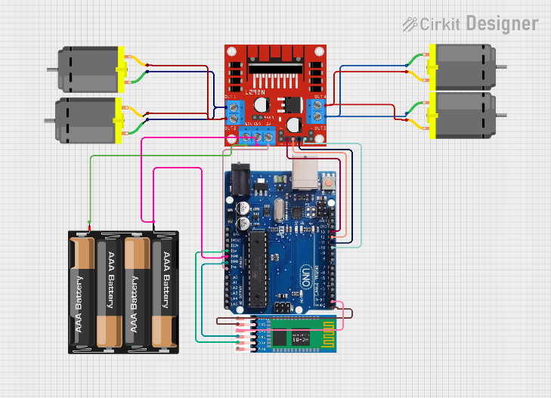
Circuit Diagram

Slide 8
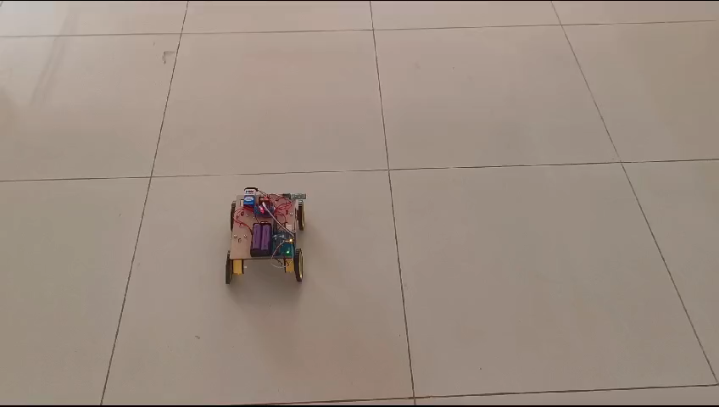
Quick Demo:

Slide 9
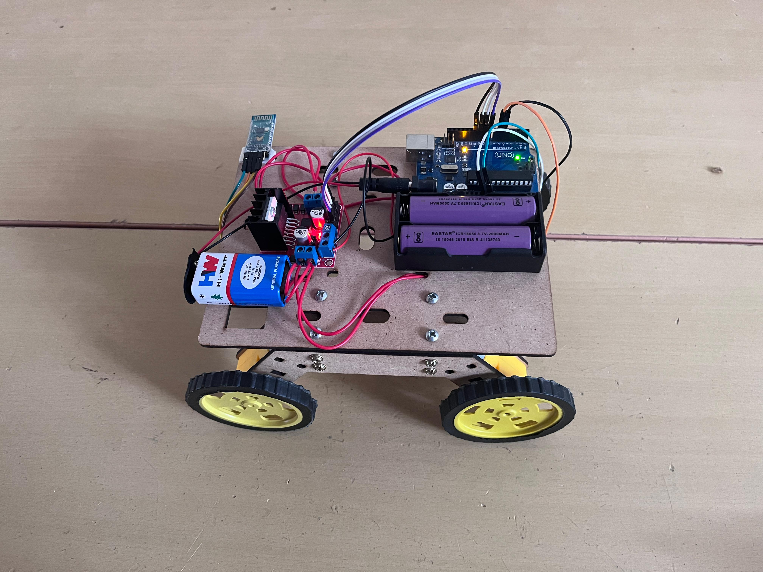
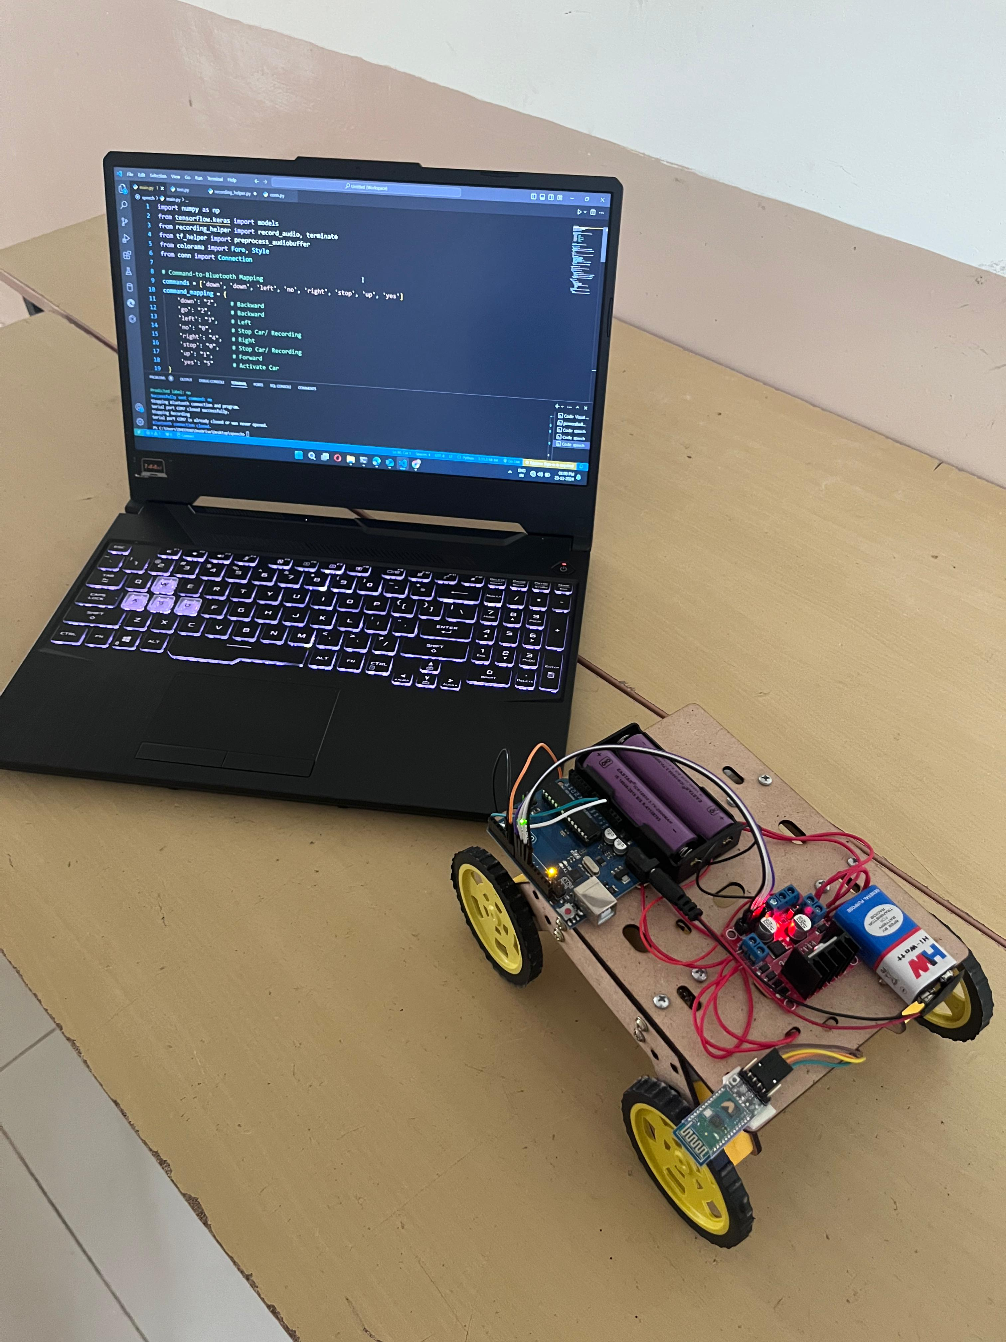
Some Pictures of the Car:

Slide 10
Dataset Overview and Data Preprocessing-
Dataset Overview-
We use mini speech commands dataset a smaller version of the Speech Commands dataset. The original dataset consists of over 105,000 audio files in the waveform (WAAV) audio file format of people saying 35 different words.
Each word has 1000 files we use 800 for training and 200 for validation of each
Data Preprocessing –
The data is first trimmed to 1sec and set to 16KHz sampling rate
Then is converted to spectrograms using STFT
We also normalise the data in this step before it is fed to the model

Slide 11
Real Time Microphone Input-
We use the PyAudio library to interact with the computer's microphone and audio system. It allows us to open a stream to capture real-time audio data.
We specify audio settings such as sampling rate (16KHz), format and buffer size. These settings control how we record the audio.
We create an input audio stream, which starts recording audio in real time, capturing small chunks of audio data continuously.
The waveform is normalized and converted into a spectrogram, which is the format used by the model for making predictions.

Slide 12
TensorFlow-
TensorFlow is an open source machine learning framework developed by google
It is used to design and build models including audio classification
TensorFlow provided the framework for building the model and allowed us to build a simple neural net for audio classification
It allowed us to easily normalise and process the data we got allowing the model to learn efficiently
It provides build in optimisers and loss functions

Slide 13
Bluetooth Communication
HC-05 is paired with the PC.
This enables serial communication with the Bluetooth module.
A serial connection is opened with the pyserial module.
This enables us to send serial data through the port.
The instruction code is serialized and sent through the port.
The HC-05 receives the data and transmits it to the serial port of the Arduino.

Slide 14
Challenges in Implementation
Command Misrecognition: Difficulty distinguishing between similar words; solution involves refining the audio model and adding more training data.
Real-Time Latency: Processing time and Bluetooth transmission delay; discuss optimizations made to minimize delays.
Audio Noise Interference: Issues with background noise; explain the use of filters or thresholds to address this.

Slide 15
Future Enhancements
We can expand the command set for the car to add more sophisticated controls like speed control, u-turns etc.
An automatic obstacle detector using ultrasonic sensors to prevent collisions.
Adding voice recognition using neural networks.

Slide 16
References-
Tensorflow - https://www.tensorflow.org
Arduino - https://www.arduino.cc
PyAudio - https://pypi.org/project/PyAudio/
HC-05 Datasheet - https://components101.com/sites/default/files/component
Pyserial documentation - https://pyserial.readthedocs.io/en/latest/
Data Set- https://www.kaggle.com/datasets/neehakurelli/google-speech-commands

Slide 17
Thank you!

